Slide 1

Introduction to Logistic Regression
Presented by:
Elizer Ponio Jr.
Department of Computer Science
College of Computing and Information Technologies

Slide 2
Outline
What is Logistic Regression?
Comparing Linear and Logistic Regression

Slide 3
Obese
Logistic Regression is similar to Linear Regression except…
Not Obese
1
2
3

Slide 4
Obese
Logistic Regression predicts whether something is True or False, instead of predicting something continuous like price.
Not Obese
1
2
3

Slide 5
Obese
These people are obese
These people are not obese
Not Obese
1
2
3
Weight

Slide 6
Obese
Instead of fitting a straight line to the data, logistic regression fits an “S” shaped logistic function
Not Obese
1
2
3
Weight

Slide 7
1
The curve goes from 0 to 1
0
1
2
3
Weight

Slide 8
1
The curve tells you the probability that a person is obese based on its weight.
0
1
2
3
Weight

Slide 9

Obese
If we weighed a very heavy person
Not Obese
1
2
3
Weight

Slide 10
Obese
There is a high probability that this person is obese.
Not Obese
1
2
3
Weight

Slide 11
Obese
If the person has an average weight
Not Obese
1
2
3
Weight

Slide 12
Obese
Then there is only a 50% chance that this person is obese.
Not Obese
1
2
3
Weight

Slide 13
Although logistic regression tells the probability that a person is obese or not, it’s usually used for classification
Obese
Not Obese
1
2
3
Weight

Slide 14
For example, if the probability of a person is greater than 50%, then we will classify it as obese, otherwise we will classify it as not obese
Obese
Not Obese
1
2
3
Weight

Slide 15
Just like Linear Regression, we can make a simple model..
Using only weight to predict Obesity
Obese
Not Obese
1
2
3
Weight

Slide 16
Or more complicated models..
Using weight, height, age and blood type to predict obesity
Obese
Not Obese
1
2
3
Weight

Slide 17
In other words, just like linear regression, logistic regression can work with continuous data (weight, height, age) and discrete data (blood type)
Obese
Not Obese
1
2
3
Weight

Slide 18
Logistic Regression’s ability to provide probabilities and classify new samples using continuous and discrete data makes it a popular machine learning method.
Obese
Not Obese
1
2
3
Weight

Slide 19
One big difference between linear and logistic regression is how the line is fit to the data
Obese
Not Obese
1
2
3
Weight

Slide 20
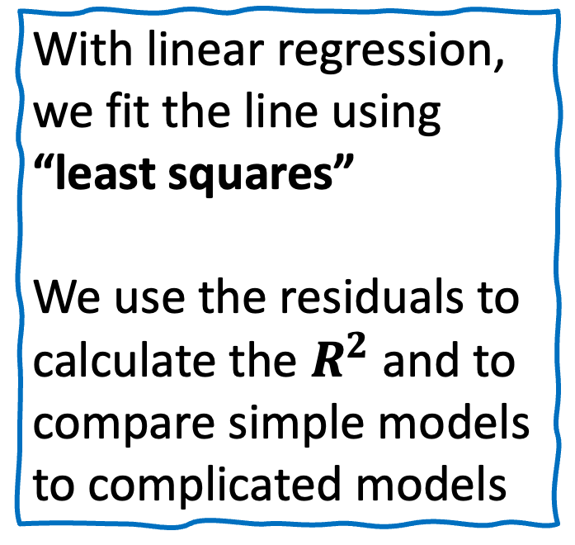
With linear regression, we fit the line using “least squares”
We use the residuals to calculate the $R^{2}$ and to compare simple models to complicated models
Jeepney Fare (Y)
Price of Fuel (X)

Slide 21
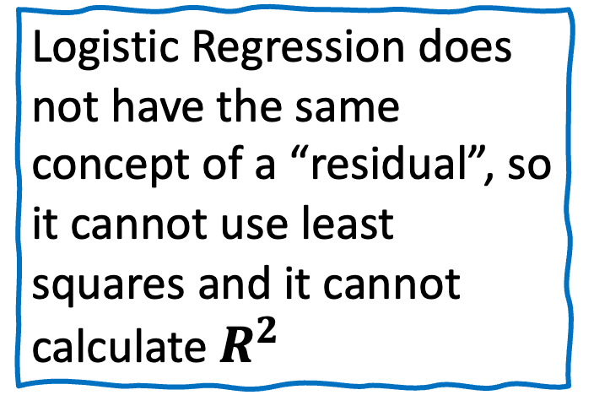
Logistic Regression does not have the same concept of a “residual”, so it cannot use least squares and it cannot calculate $R^{2}$
Obese
Not Obese
1
2
3
Weight

Slide 22
Instead, it uses something called “Maximum Likelihood”
Obese
Not Obese
1
2
3
Weight

Slide 23
Logistic Function
The name “logistic regression” is derived from the concept of the logistic function that it uses.
The logistic function is also known as the sigmoid function.
The value of this logistic function lies between 0 and 1, which cannot go beyond this limit, so it forms a curve like an “S” form.

Slide 24
Linear Regression | Logistic Regression
It is used for solving regression problems | It is used for solving classification problems
We find best fit line. | We find S-Curve.
Least square estimation method is used for estimation of accuracy. | Maximum likelihood estimation method is used for estimation of accuracy.

Slide 25
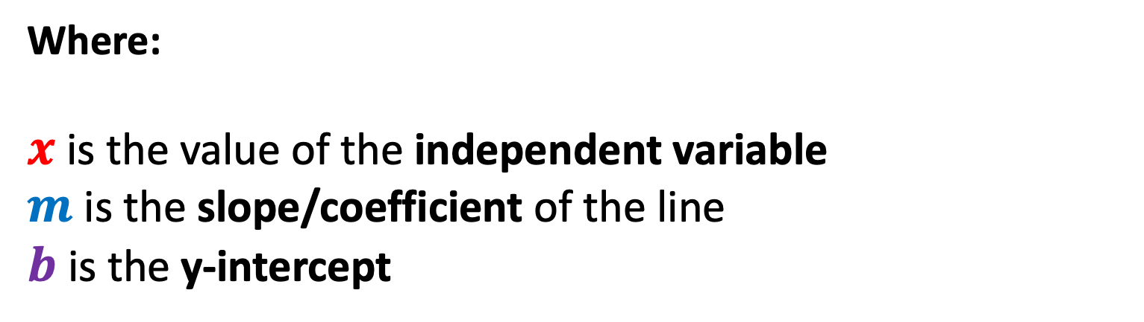
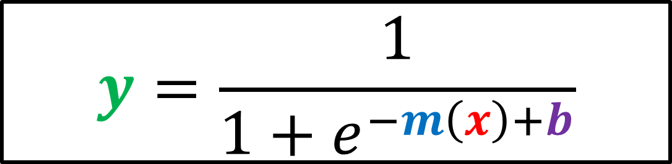
Logistic/Sigmoid Function
$$y=\frac{1}{1+e^{−m\left(x\right)+b}}$$
Where:
$x$ is the value of the independent variable
$m$ is the slope/coefficient of the line
$b$ is the y-intercept

Slide 26
Student | Study Hours (x₁) | Sleep Hours (x₂) | Pass (y)
A | 2 | 5 | 0
B | 3 | 6 | 0
C | 4 | 5 | 0
D | 6 | 6 | 1
E | 7 | 5 | 1

Slide 27
$$y=\frac{1}{1+e^{−m\left(x\right)+b}}$$
Because we now have two independent variables, we need to extend this equation

Slide 28
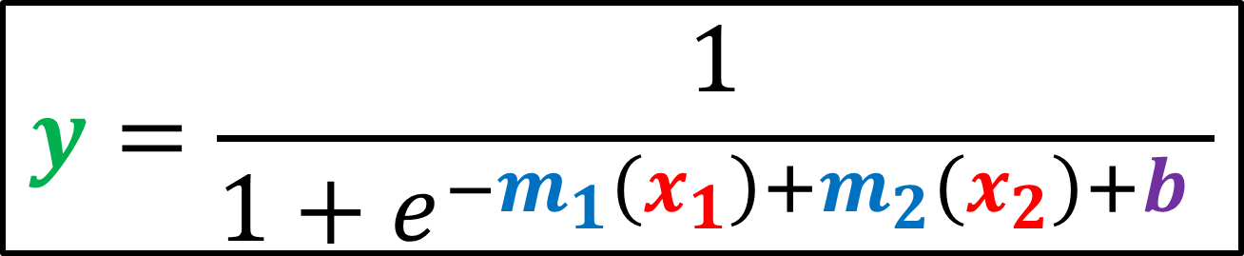
$$y=\frac{1}{1+e^{−m_{1}\left(x_{1}\right)+m_{2}\left(x_{2}\right)+b }}$$
Because we now have two independent variables, we need to extend this equation

Slide 29

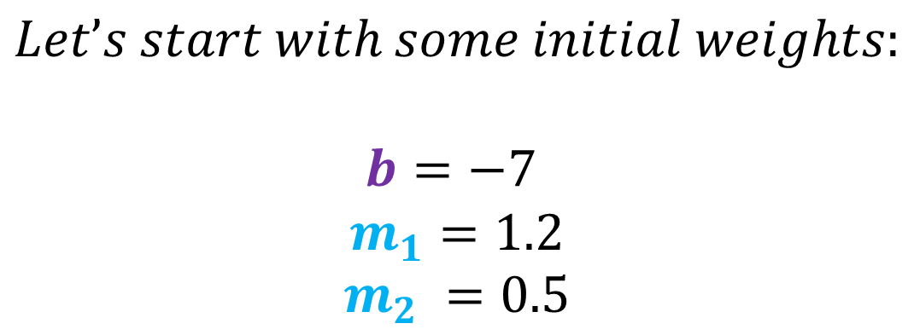
$$y=\frac{1}{1+e^{−m_{1}\left(x_{1}\right)+m_{2}\left(x_{2}\right)+b }}$$
$$Let’s start with some initial weights:$$
$$b=−7$$
$$m_{1}=1.2$$
$$m_{2} =0.5$$

Slide 30
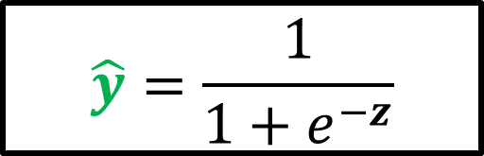

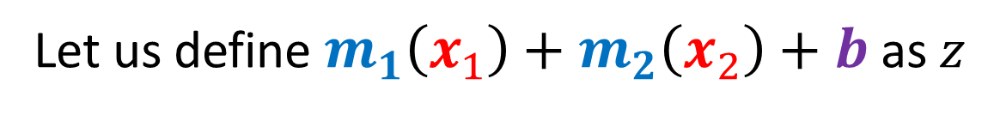
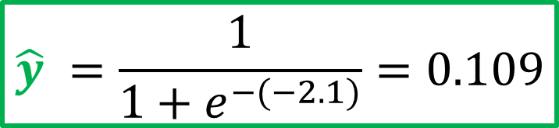
Compute the probability of Student A
$$z=m_{1}\left(x_{1}\right)+m_{2}\left(x_{2}\right)+b$$
$$z=1.2\left(2\right)+0.5\left(5\right)+\left(−7\right)=−2.1$$
Let us define $m_{1}\left(x_{1}\right)+m_{2}\left(x_{2}\right)+b$ as $z$
$$\hat{y}=\frac{1}{1+e^{−z}}$$
$$\hat{y} ​=\frac{1}{{1+e}^{−(−2.1)}}=0.109$$

Slide 31

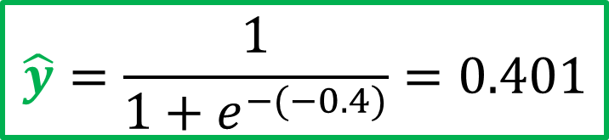
Compute the probability of Student B
$$z=m_{1}\left(x_{1}\right)+m_{2}\left(x_{2}\right)+b$$
$$z=1.2\left(3\right)+0.5\left(6\right)+\left(−7\right)=−0.4$$
Let us define $m_{1}\left(x_{1}\right)+m_{2}\left(x_{2}\right)+b$ as $z$
$$\hat{y}=\frac{1}{1+e^{−z}}$$
$$\hat{y}=\frac{1}{{1+e}^{−(−0.4)}}=0.401$$

Slide 32

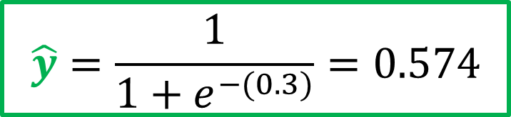
Compute the probability of Student C
$$z=m_{1}\left(x_{1}\right)+m_{2}\left(x_{2}\right)+b$$
$$z=1.2\left(4\right)+0.5\left(5\right)+\left(−7\right)=0.3$$
Let us define $m_{1}\left(x_{1}\right)+m_{2}\left(x_{2}\right)+b$ as $z$
$$\hat{y}=\frac{1}{1+e^{−z}}$$
$$\hat{y}=\frac{1}{{1+e}^{−(0.3)}}=0.574$$

Slide 33


Compute the probability of Student D
$$z=m_{1}\left(x_{1}\right)+m_{2}\left(x_{2}\right)+b$$
$$z=1.2\left(6\right)+0.5\left(6\right)+\left(−7\right)=3.2$$
Let us define $m_{1}\left(x_{1}\right)+m_{2}\left(x_{2}\right)+b$ as $z$
$$\hat{y}=\frac{1}{1+e^{−z}}$$
$$\hat{y}=\frac{1}{{1+e}^{−(3.2)}}=0.961$$

Slide 34


Compute the probability of Student E
$$z=m_{1}\left(x_{1}\right)+m_{2}\left(x_{2}\right)+b$$
$$z=1.2\left(7\right)+0.5\left(5\right)+\left(−7\right)=3.9$$
Let us define $m_{1}\left(x_{1}\right)+m_{2}\left(x_{2}\right)+b$ as $z$
$$\hat{y}=\frac{1}{1+e^{−z}}$$
$$\hat{y}=\frac{1}{{1+e}^{−(3.9)}}=0.980$$

Slide 35
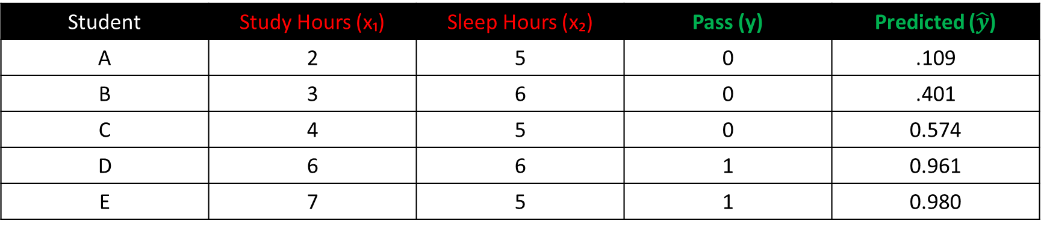
Prediction Results
Student | Study Hours (x₁) | Sleep Hours (x₂) | Pass (y) | Predicted ($\hat{y}$)
A | 2 | 5 | 0 | .109
B | 3 | 6 | 0 | .401
C | 4 | 5 | 0 | 0.574
D | 6 | 6 | 1 | 0.961
E | 7 | 5 | 1 | 0.980

Slide 36
Computing Loss (Binary Cross-Entropy)
$${loss}_{i}=−(y_{i}×ln⁡(\hat{y_{i}})+\left(1−y_{i}\right)×ln⁡(1−\hat{y_{i}}))$$

Slide 37
Compute the loss of Student A
$${loss}_{i}=−(y_{i}×ln⁡(\hat{y_{i}})+\left(1−y_{i}\right)×ln⁡(1−\hat{y_{i}}))$$
$${loss}_{i}=−(0×ln⁡(−0.109)+\left(1−0\right)×ln⁡(1−0.109)))$$
$${loss}_{i}=−(0+1×ln⁡(1−0.109)))$$
$${loss}_{i}=−\ln\left(1−0.109\right)$$
$${loss}_{i}=−\ln\left(.8909\right))=0.1155$$

Slide 38
Compute the loss of Student B
$${loss}_{i}=−(y_{i}×ln⁡(\hat{y_{i}})+\left(1−y_{i}\right)×ln⁡(1−\hat{y_{i}}))$$
$${loss}_{i}=−(0×ln⁡(−0.401)+\left(1−0\right)×ln⁡(1−0.401)))$$
$${loss}_{i}=−(0+1×ln⁡(1−0.401)))$$
$${loss}_{i}=−(\ln\left(1−0.401\right))$$
$${loss}_{i}=−\ln\left(0.5987\right))=0.5130$$

Slide 39
Compute the loss of Student C
$${loss}_{i}=−(y_{i}×ln⁡(\hat{y_{i}})+\left(1−y_{i}\right)×ln⁡(1−\hat{y_{i}}))$$
$${loss}_{i}=−(0×ln⁡(−0.574)+\left(1−0\right)×ln⁡(1−0.574)))$$
$${loss}_{i}=−(0+1×ln⁡(1−0.574)))$$
$${loss}_{i}=−(\ln\left(1−0.574\right))$$
$${loss}_{i}=−\ln\left(0.4256\right))=0.8544$$

Slide 40
Compute the loss of Student D
$${loss}_{i}=−(y_{i}×ln⁡(\hat{y_{i}})+\left(1−y_{i}\right)×ln⁡(1−\hat{y_{i}}))$$
$${loss}_{i}=−(1×ln⁡(−0.960)+\left(1−1\right)×ln⁡(1−.960)))$$
$${loss}_{i}=−(ln⁡(1−0.960)+0×ln⁡(1−0.960)))$$
$${loss}_{i}=−(\ln\left(1−0.960\right))$$
$${loss}_{i}=−\ln\left(0.960\right))=0.03995$$

Slide 41
Compute the loss of Student D
$${loss}_{i}=−(y_{i}×ln⁡(\hat{y_{i}})+\left(1−y_{i}\right)×ln⁡(1−\hat{y_{i}}))$$
$${loss}_{i}=−(1×ln⁡(−0.980)+\left(1−1\right)×ln⁡(1−.980)))$$
$${loss}_{i}=−(ln⁡(1−0.980)+0×ln⁡(1−0.980)))$$
$${loss}_{i}=−(\ln\left(1−0.960\right))$$
$${loss}_{i}=−\ln\left(0.980\right))=0.02004$$

Slide 42
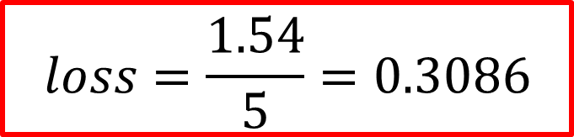
$loss=$ $\frac{loss\left(Student A\right)+loss\left(Student B\right)\text{+ }loss\left(Student C\right)\text{+ }loss\left(Student D\right)\text{+ }loss\left(Student E\right)}{5}$
$$loss=\frac{0.1155+0.5130+0.8544+0.03995+0.02004​}{5}$$
$$loss=\frac{1.54​}{5}=0.3086$$

Slide 43
References
https://www.youtube.com/watch?v=yIYKR4sgzI8&list=PLblh5JKOoLUKxzEP5HA2d-Li7IJkHfXSe&index=1

